Slide 1
Storm surge cases
Hans von Storch
(IfK@HZG, CLISAP@UHH – Germany)
江文胜(Jiang Wensheng)
中国海洋大学 (OUC) 青岛
Kazimierz Furmańczyk
U Szczecin – Poland
27 September 2016 - College of Marine Sciences, Shanghai Ocean University (SHOU), 上海 (Shanghai)
Analysis of Historical Storms and Storm surges
Notes:
12 minutes

Slide 2
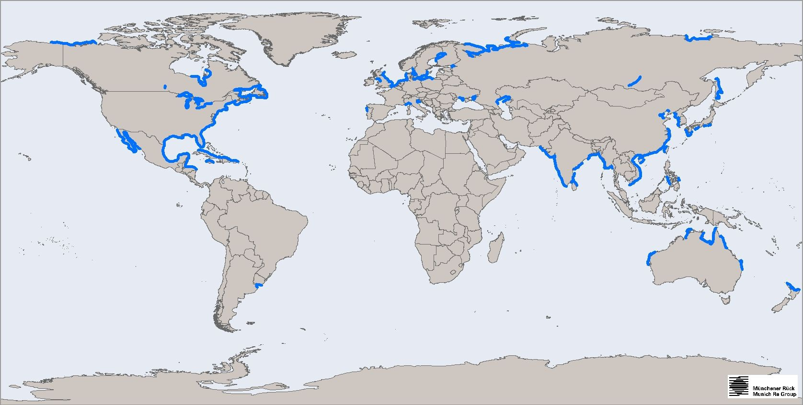
Global distribution of storm surges
Storm surge research is fragmented
following different disciplines
(coastal engineering, operational oceanography, coastal climate, risk management, others?)
following different regions
Spatial distribution of storm surge risks according to Munich Re

Slide 3
Cases
30 December 1913 - Dziwnów, Poland
16 February 1962 – Hamburg, Germany
30 August 1939 - Qingdao, China

Slide 4
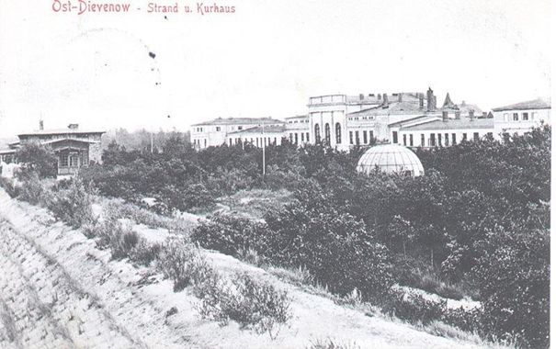
30 December 1913
- Dziwnów, Poland
Originally, Dziwnów was initially a small fishing village at the Southern Baltic Sea coast. Beginning at about 1890, it gained importance as a holiday and spa resort. Hotels and health centers, including “Kurhaus” (the greatest at the Baltic coast), a beach hall, a promenade on the dune, beach baths, and a pier were constructed. It became a popular holiday destination on the Baltic coast.
On 30 December 1913, a substantial storm devastated Dziwnów. Several buildings and tourist infrastructure, including Kurhaus, were destroyed. The resort town never recovered in full.
The storm began on 27 December with strong N-NW winds (Beaufort 8-9). On 30 December the winds shifted to N-NE and formed a strong storm surge. Storm surge levels of +1.98 m were recorded for Świnoujście, and +1.82m for Kiel.
In the afternoon of 30 December water overflowed the low dunes and flooded the low-lying hinterland.

Slide 5
16 February 1962
– Hamburg, Germany
The history of storm surges in Hamburg since 1750:
(1) a frequent damage period (prior to 1850) - Storm surges and breaking dikes were relative frequent in Hamburg. Dike failures took place at water levels of about +5.20 m. Eventually dike heights were raised to +5.70 m.
(2) a calm period (1855-1962). Only one severe storm surge happened
(in 1855). For more than 100 years, the improved dike levels were not really
challenged; all gauge readings were below +5.00 m.
(3) a period of elevated but well-managed storm surge levels (1962 to present)
After a catastrophic storm surge in 1962 dikes were raised to +7.20 m.
Since then coastal defense held and damages were insignificant in Hamburg.
The major reason for the elevated storm surges since 1962 was the
transformation of the river into a channel for better shipping and improved
coastal defense, while sea level rise played a secondary role.
The 1962 storm surge killed more than 300 people in Hamburg. The badly
maintained dikes broke in several locations and the civil defense for the case
of a dike failure turned out to be inefficient.
Storm surge heights (vertical bars) and dike heights (red horizontal lines) as recorded at the tide gauge St Pauli in Hamburg from 1750 to 2004. The color coding represents different surge heights. The red stars indicate dike failures.
Flooded areas (blue) during the storm surge of February 16, 1962, in Hamburg. The black line describes the coastal defense line; the red triangles represent dike failures.

Slide 6
30 August 1939 - Qingdao, China
A nameless typhoon formed on 22 August 1939, in the Pacific Ocean.
- On the evening of 30 August 1939 the typhoon approached Qingdao
and was accompanied by severe precipitation.
- At 6 am on 31 August, the typhoon center was about 120 km south of Qingdao
and the wind speed in Qingdao likely exceeded 150 km/h.
- At 9 am the typhoon made landfall on the west coast of Qingdao’s Jiaozhou Bay.
In Qingdao city, 17 people were killed by storm surge. More than 1,000 houses were
destroyed and an additional 3,000 houses were damaged. About 460 ha of farmland
near the coast was inundated. The loss of grain harvest was estimated at approximately
11,000 tons. The total economic loss was equivalent to US$ 4 million.
The disaster is still remembered by the local people through oral transmission from the community elders.
More recently, in August 1985, a storm surge disaster happened when Typhoon Mamie hit Qingdao. 29 people were killed and 368 people were wounded. More than 8,000 m of sea dikes and other coastal defense measures were destroyed. The economic loss was equivalent to around US$ 200 million.

Slide 7
D&A – statistics needed
A key issue in current climate science is the question if the statistics of (atmospheric and oceanic) weather have changed.
A significant aspect is risks, such as storm surges.
For finding and describing changes in the statistics of storm surges, long times series of the timing, the frequency and the intensity of such storm surges is needed.
Such changes may be due to decadal climate variability, but also to global climate change (sea level rise, changing storm characteristics) or to local (morphological) changes (such a dredging shipping channels).
The task of identifying a change beyond the natural variability is called detection. The task of explaining a detected change is named attribution.
D&A (detection and attribution) is a key effort prior to implementing adaptive efforts for reducing risks and designing risk management.
Knowledge about characteristics of historical storm surges is needed.

Slide 8
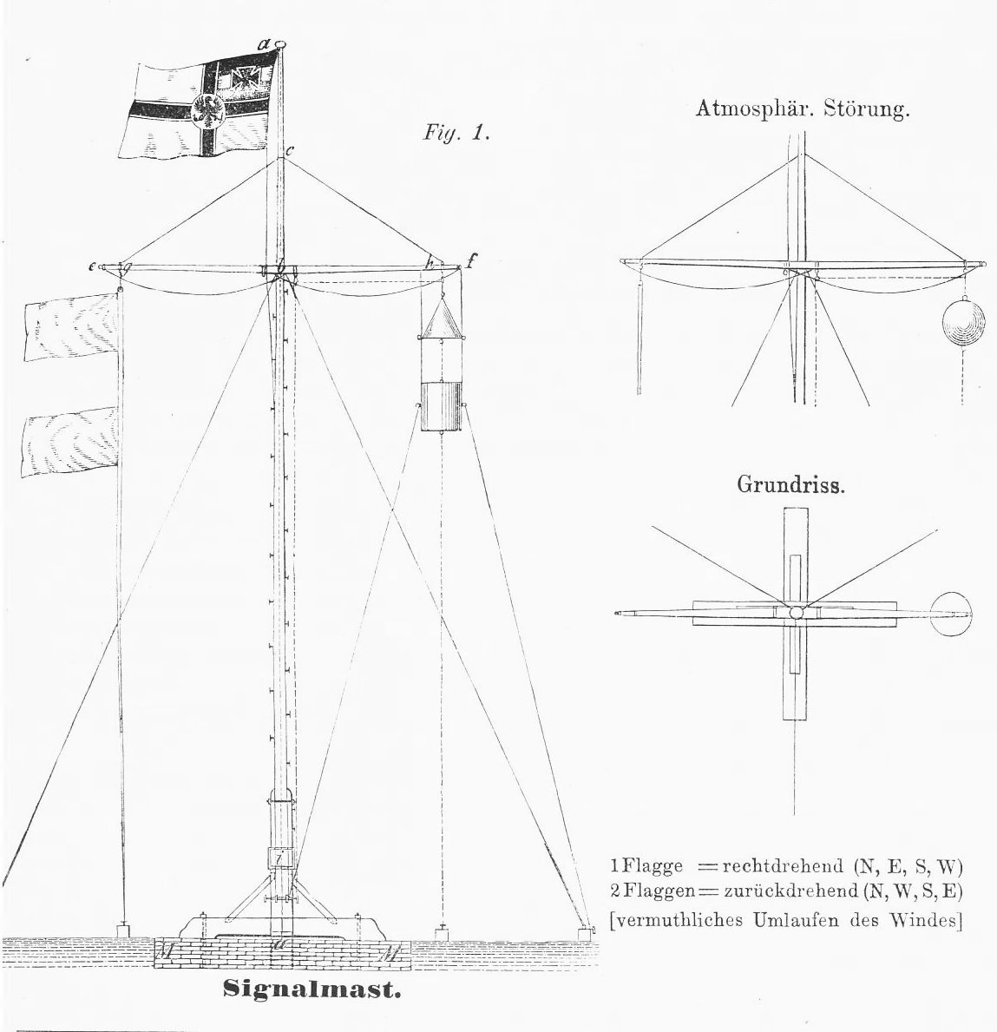
Additional historical data
– signal station data
Synoptic data were collected at warning posts in harbors along the German coast, at called “Signalstationen”.
1877 – 1939 (- 1999)
Estimated wind-speed and direction, wave conditions, air pressure and precipitation.
Signal Stations were positioned close to the shore to convey severe weather warning to ships and the coastal population. This was done by raising optical signals such as balloons, triangles, cylinders and flags.
Reports were prepared 3 to 9 times per day. These observations did not enter the regular weather analysis process of the weather service, but were later archived.
About 800 handwritten journals are archived at the German Meteorological Service in Hamburg, and some are now available for further analysis.

Slide 9
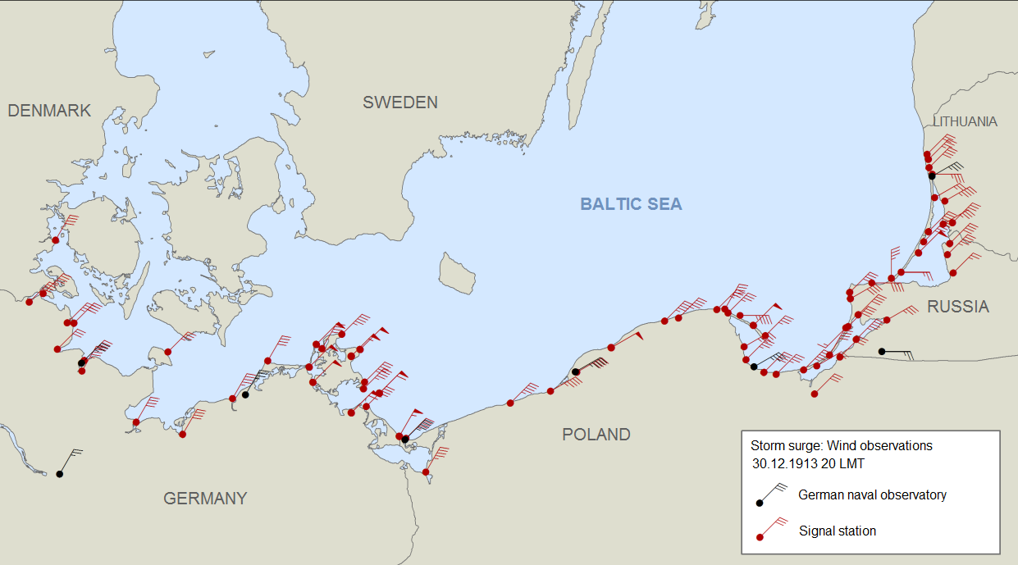
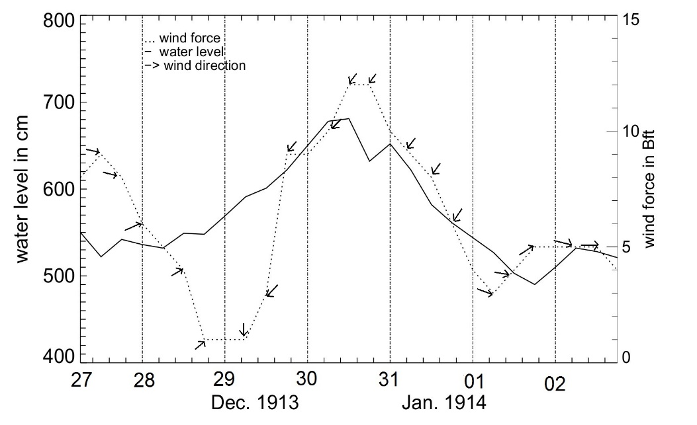
30 December 1913
- Dziwnów, Poland
Positions and wind observations of the signal stations which reported on 30th December 1913. The red flags represent the data of signal stations and the black ones represent data of the German Naval Observatory.
For the analysis of the storm surge on 30 December 1913 at Dziwnów, Poland in the southwestern Baltic Sea Coast wind and air pressure data of signal stations and the German naval observatory were used.
Chronological sequences of water level, air pressure, water temperature, wind force and wind direction at Greifswalder Oie (Data:BSH).

Slide 10
Dynamical modelling of past events
Rosenhagen & Bork, 2009
When state of the atmosphere is known, hydrodynamical models may be used to re-analyse the resulting storm surge.
Example: 13. November 1872, southwestern Baltic Sea coast; an extraordinary surge, with heights far beyond what has been observed ever since. (Rosenhagen, G., and I. Bork, 2009: Rekonstruktion der Sturmflutwetterlage vom 13. November 1872, Küste 75: 51-70)
Hydrodynamical modelling may supply estimates of „normal range“ auf extreme events
Bohai: 冯建龙 (Feng J.), H. von Storch, R. Weisse, and 江文胜 (Jiang W.), 2016: Changes of storm surges in the Bohai Sea derived from a numerical model simulation, 1961-2006.Ocean Dynamics; (see separate preentation by冯建龙 (Feng J.))
North Sea: Langenberg, H., A. Pfizenmayer, H. von Storch and J. Sündermann, 1999: Storm related sea level variations along the North Sea coast: natural variability and anthropogenic change.- Cont. Shelf Res. 19: 821-842
Rosenhagen & Bork, 2009

Slide 11
Summary
von Storch, H., 江文胜 (Jiang W.), and K K. Furmańczyk, 2014: Storm Surge Case Studies. In J. Ellis, D. Sherman, and J.F. Schroder (eds): Coastal and Marine Natural Hazards and Disasters, Elsevier Treatise in Hazards and Disasters Coastal and Marine Hazards, Risks, and Disasters ISBN: 978-0-12-396483-0, 181-196
Wagner, D., B. Tinz, and H. von Storch, 2016: Newly Digitized Historical Climate Data of the German Bight and the Southern Baltic Sea Coasts. J. Atmos Ocean Technology, in press
Long time series of historical storm surges are needed
For understanding processes and drivers of storm surges
For assessing the risk of rare events
For assessing change and
For projecting future developments
but also
For assessing disaster management
For assessing the effects of water works
To do so, we need more historical data of past rare events. This can be achieved by additional data, which may be forgotten in forgotten archives. It can also be achieved by setting up hydro-dynamical models, which process estimates of past weather states.

Slide 12
