Slide 1
How can we improve our communication of science?

Slide 2
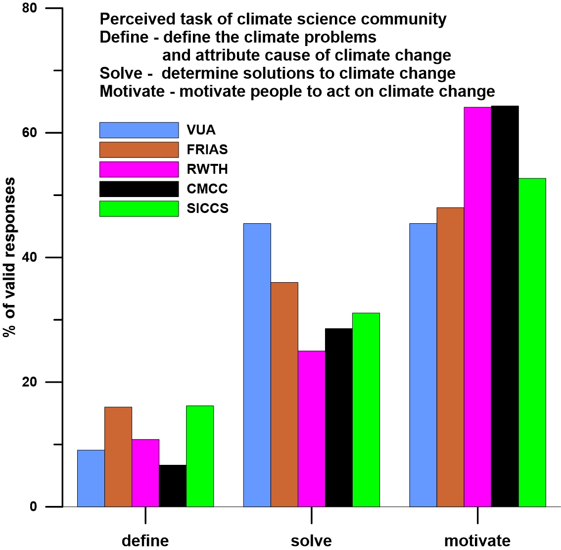
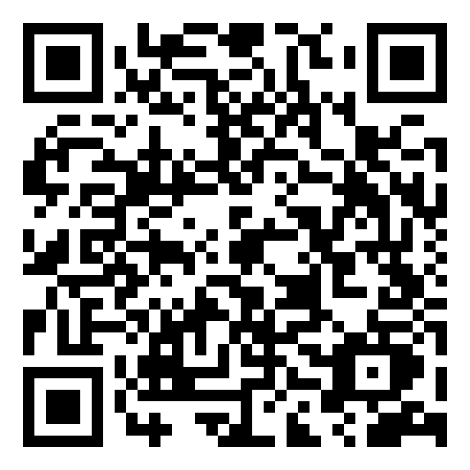
Who is „we“?
Are we …
… seeing the motivation as key task?
or
…. the understanding of the climate system, the sensitivities …

Slide 3
We = motivation as main task
Use a narrative, which is going along with a steady increase of pending disaster –
Sequence - breakdown of Gulf stream - not 1 but 6 tipping points - perspective of Earth unsuitable for human life - cascade of tipping points
Recipe - limit climate change to 2° temperature rise in 2100 - limit climate change to 1.5° temperature change in 2100 - cap temp increase by 1.5 all times
Is this a sustainable use of the resource „knowldge“?

Slide 4
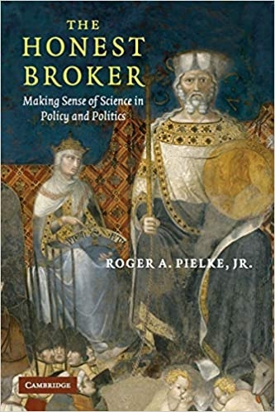
We = learning about climate dynamics as main task
Use the resource „scientifically constructed knowledge“ (vetenskap) sustainably.
Use the concept of an Honest Broker – i.e., present the knowledge and the limit of the knowledge, evaluate chances of success and failure in a broad societal context.
Use CUDOS norms of scientific practice.
Insist on scientific rigor.
Be open to alternative ideas; try to falsify own knowledge claims

Slide 6
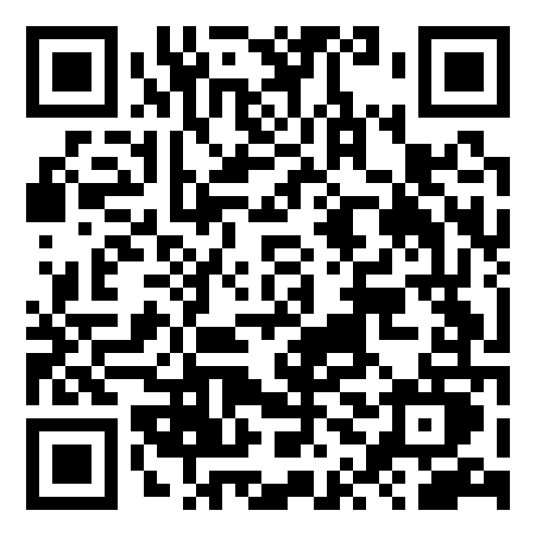
How can we be honest in science communication including all uncertainties and still be convincing to the press and to the general public?

Slide 7
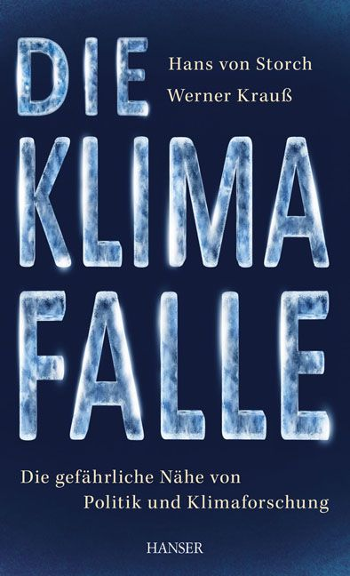
What to do?
Accept - science is a social process. - post-normal conditions when they prevail. - science is not unveiling truth but provides best explanations. - present knowledge claims may turn out to be false.
When leaving your territory of competence, extend range of cooperation – include social scientists when needed, but try to understand which type of knowledge social sciences build, using which premises. (“Extended peer review”)
When leaving the territory of science, and entering the public / political realm, accept that our knowledge is rather narrow, and provides only a small segment of needed knowledge. (“Campfire”-concept of Krauss and von Storch)
Accept that policymaking is not an optimization problem, but an effort to a balance societal values, and that science strives for best explanations, not for (eternal) truth.

Slide 8
Knowledge market
The science-policy/public interaction is not an issue of „knowledge speaks to power“.
The problem is not that the public is stupid or uneducated. The idea of the “gap model”, according to which people simply do not understand the problem, but will draw the right conclusions when taught accordingly, is false.
The problem is that the scientific knowledge is confronted on the „explanation marked“ with other forms of knowledge (pre-scientific, outdated; traditional, morphed by different interests). Scientific knowledge does not necessarily “win” this competition.
The social process „science“ is influenced by these other knowledge forms.
Science can not be objective but should nevertheless strive to be so.
Notes:
8

Slide 9
Predictions based on post-normal conditions
Science is „de-scientized“, and „politicized“.
Policy is „de-politicized“, and „scientized“.
Policy decisions are framed as being “without alternative” – scientific knowledge claims are presented as leading to unique „solutions“ which need to be implemented without further democratic influence on the substance.
Some scientists act as policy activists, while exploiting their public authority as scientists.
Emergence of different knowledge claims, among them “alternative facts”.

Slide 11
Robert K. Merton‘s CUDOS (1942) Norms for the basic natural scientists
Communalism: the common ownership of scientific discoveries, according to which scientists give up intellectual property rights in exchange for recognition and esteem.
Universalism: according to which knowledge claims are evaluated in terms of universal or impersonal criteria, and not on the basis of race, class, gender, religion, or nationality.
Disinterestedness: scientists, when presenting their work publicly, should do so without any prejudice or personal values and do so in an impersonal manner.
Organized skepticism: all ideas must be tested and are subject to rigorous, structured community (peer review) scrutiny.

Slide 12
Postnormal science
Jerry Ravetz, Silvio Funtowicz, 1986 and earlier
State of science, when facts uncertain, values in dispute, stakes high and decisions urgent.
In this state, science is not only done for reasons for curiosity but is asked for as support for preconceived value-based agendas.
Climate Science is in a post-normal phase (Bray and von Storch, 1999)
facts uncertain: e.g. sensitivity of global mean temperature to doubling of CO2 concentration
values in dispute, e.g., do we cement the world according to our present preferences or do we accept a generationally dynamical development?
stakes high, e.g., costs for re-organizing global energy market and future damages
decisions urgent, e.g., to be efficient, re-organization of e.g. traffic must be begun now.
Silvio Funtowicz and Jerry Ravetz

