Slide 1
On detection and attribution …
Second thoughts
Hans von Storch, Eduardo Zorita and Armineh Barkhordarian
Institut für Küstenforschung
Helmholtz Zentrum Geesthacht
2. October 2013, Zürich, ETHZ

Slide 2
Detection and attribution
Detection: Determination if observed variations are within the limits of variability of a given climate regime. If this regime is the undisturbed, this is internal variability (of which ENSO, NAO etc. are part)
If not, then there must be an external (mix of) cause(s) foreign to the considered regime.
Attribution: In case of a positive detection: Determination of a mix of plausible external forcing mechanisms that best “explains” the detected deviations
Issues: Uniqueness, exclusiveness, completeness of possible causes
hzg2013$

Slide 3
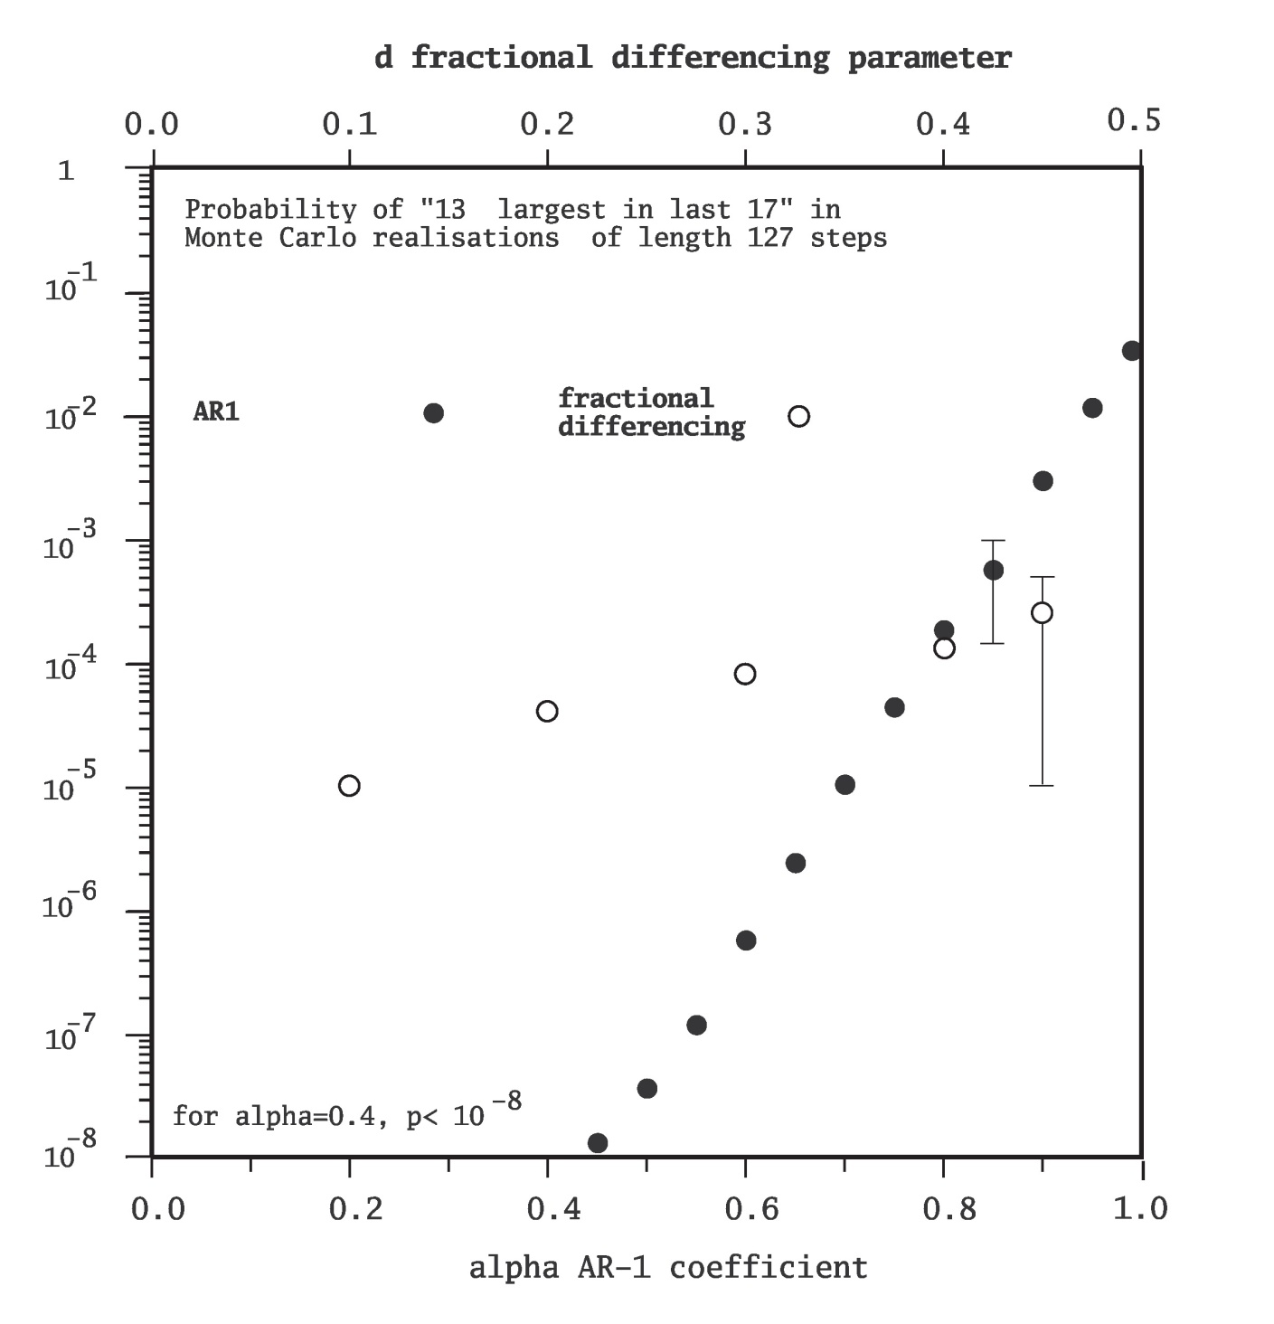
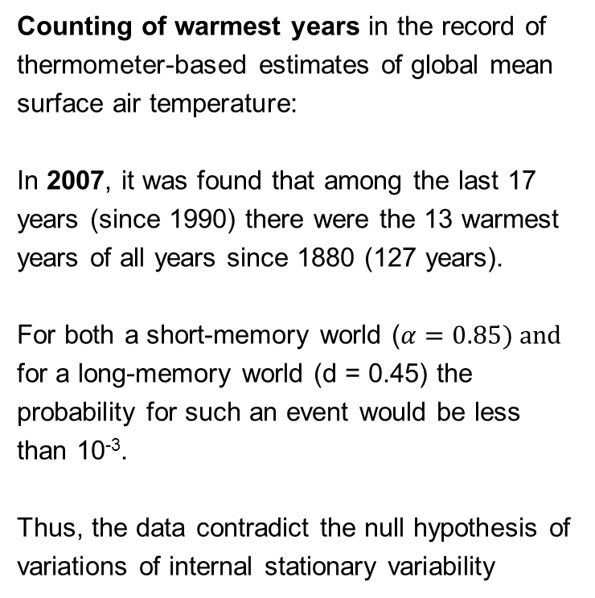
Clustering of warmest years
Counting of warmest years in the record of thermometer-based estimates of global mean surface air temperature:
In 2007, it was found that among the last 17 years (since 1990) there were the 13 warmest years of all years since 1880 (127 years).
For both a short-memory world ($α=0.85) and$ for a long-memory world (d = 0.45) the probability for such an event would be less than 10⁻³.
Thus, the data contradict the null hypothesis of variations of internal stationary variability
Zorita, E., T. Stocker and H. von Storch, 2008: How unusual is the recent series of warm years? Geophys. Res. Lett. 35, L24706, doi:10.1029/2008GL036228,

Slide 4
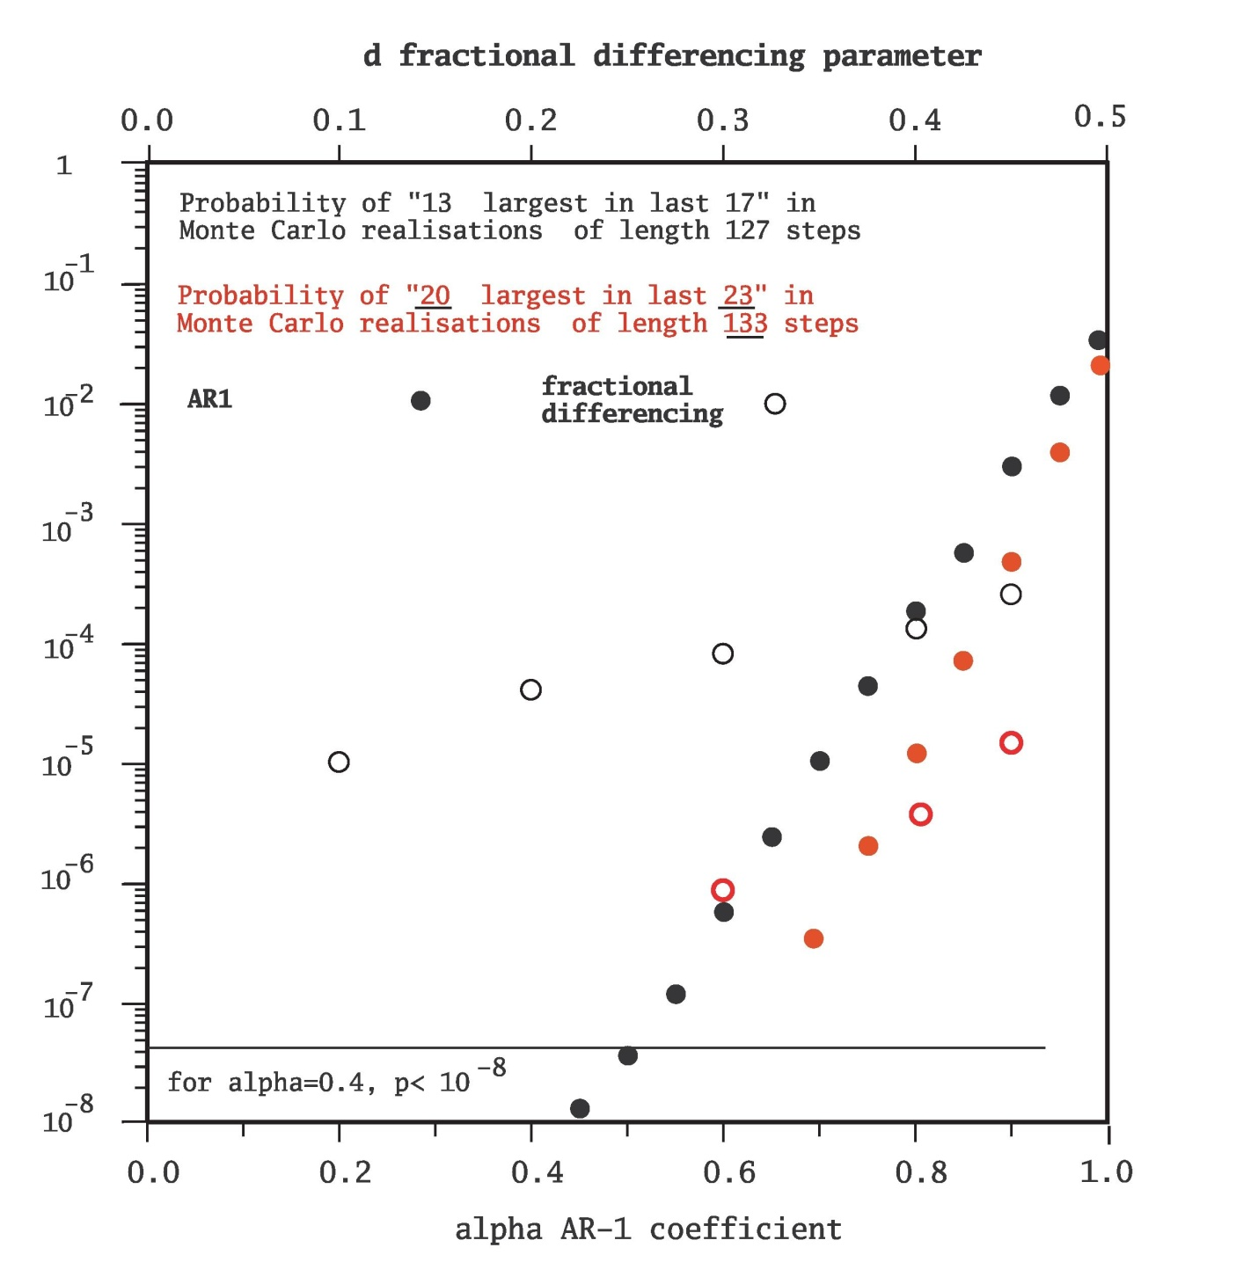
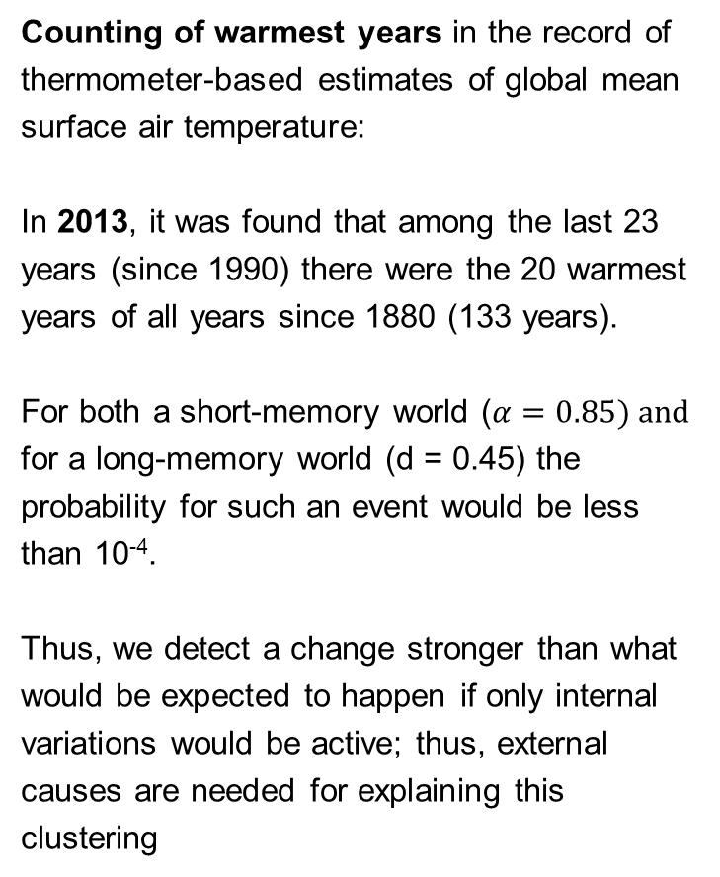
Counting of warmest years in the record of thermometer-based estimates of global mean surface air temperature:
In 2013, it was found that among the last 23 years (since 1990) there were the 20 warmest years of all years since 1880 (133 years).
For both a short-memory world ($α=0.85) and$ for a long-memory world (d = 0.45) the probability for such an event would be less than 10⁻⁴.
Thus, we detect a change stronger than what would be expected to happen if only internal variations would be active; thus, external causes are needed for explaining this clustering

Slide 5
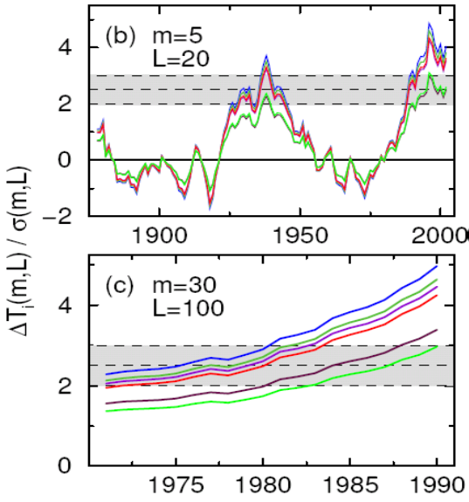
The Rybski et al-approach
Temporal development of ΔT_{i}(m,L) = T_{i}(m) – T_{i-L}(m) divided by the standard deviation of the m-year mean reconstructed temp record
for m=5 and L=20 (top), and
for m=30 and L=100 years.
The thresholds R = 2, 2.5 and 3σ are given as dashed lines; they are derived from temperature variations modelled as Gaussian long-memory processes fitted to various reconstructions of historical temperature.
Rybski, D., A. Bunde, S. Havlin,and H. von Storch, 2006: Long-term persistence in climate and the detection problem. Geophys. Res. Lett. 33, L06718, doi:10.1029/2005GL025591

Slide 6
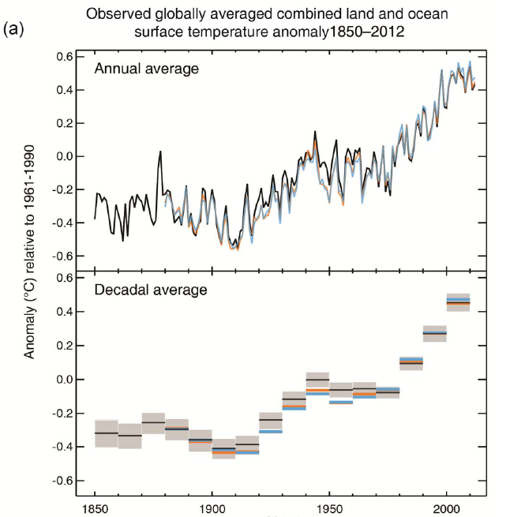
… there is something to be explained
Thus, there is something going on in the global mean air temperature record, which needs to be explained by external factors.
From various studies it is known, that a satisfying explanation is possible when considering GHGs as a dominant factor.
IPCC AR5, SPM

Slide 7
The stagnation
The temperature trend in the past 15 years, beginning with 1998 was rather low.
Is there a detectable difference of this trend from the expectation of such 15-year trends as generated in scenarios driven with dominant GHG forcing change (and minor sulfate forcing)?
“Considered climate regime” = change under dominant GHG increase (similar to the present increase)
The results to not depend very much on the rather warm ENSO year in 1998.
von Storch, H. A. Barkhordarian, K. Hasselmann and E. Zorita, 2013: Can climate models explain the recent stagnation in global warming? Rejected by nature, published by Klimazwiebel;
Similar results by Fyfe, J., N. P. Gillett and F. W. Zwiers, 2013:Overestimated global warming over the past 20 years, nature climate change 3, 767-769

Slide 8
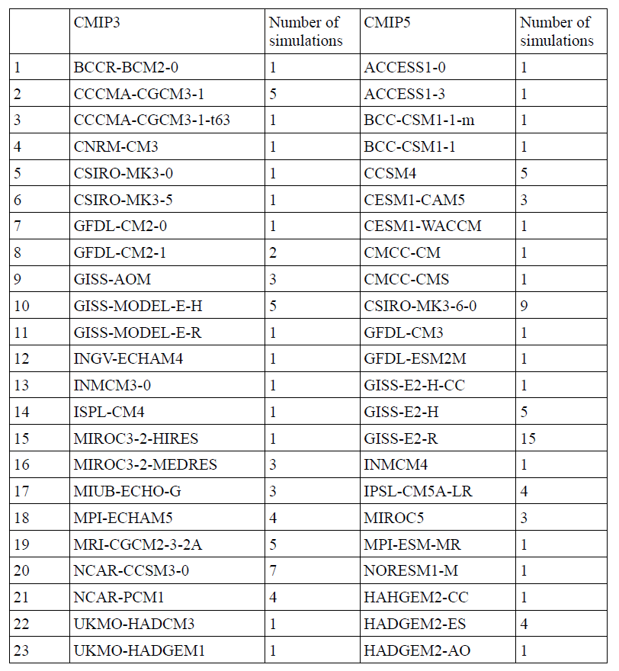
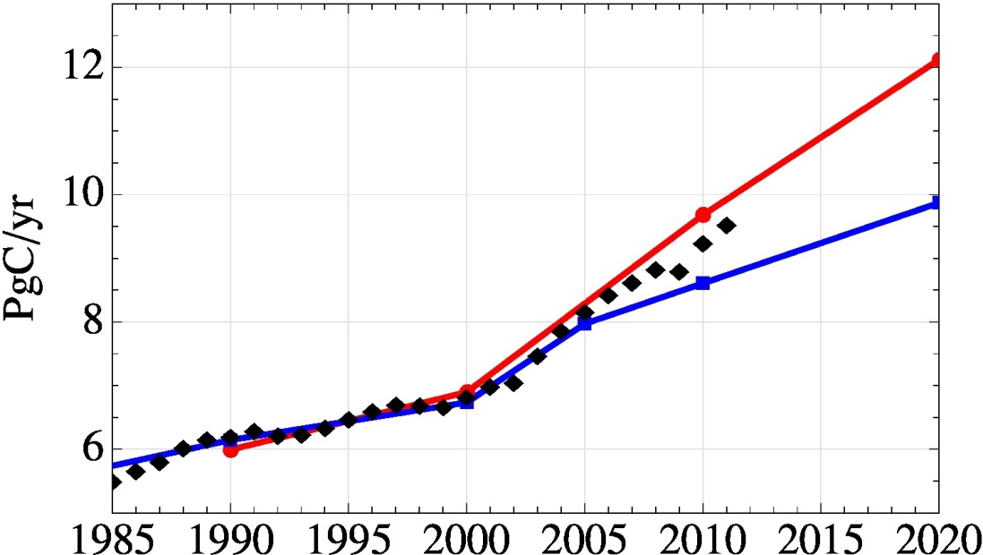
We consider all available scenario simulations in CMIP 3 run with A1B, and all in CMIP 5 with RCP4.5 – as these emission scenarios are consistent with recent actual emissions. Only until 2060.
Anthropogenic carbon emissions according to the SRES scenario A1B (red) and RCP4.5 (blue) compared to estimated anthropogenic emissions

Slide 9
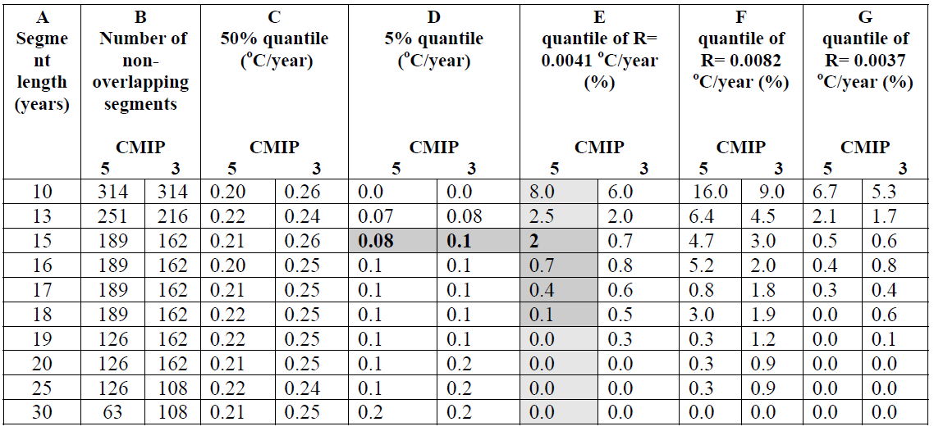
Statistics of 15 year trends in scenarios
HadCDRUT4
GISSTEMP
NCDCD
A measure of consistency between the observed trend in the global mean annual temperature, should it continue for a total of n years (A),
and the trends simulated by the CMIP3 and CMIP5 climate model ensemble in the 21st century up to year 2060;
B indicates the number of non-overlapping trends;
C and D, the estimated 50% and 5%iles of the ensemble of simulated trends (the shaded cells indicate the 5%-til for 15 year segments;
E, F and G, the quantiles corresponding to the observed trend in 1998-2012 in the HadCRUT4 ,GISSTEMP and NCDCD temperature data sets

Slide 10
Footnote
The analysis, to what extent the observed 15-year trend is consistent with the ensemble of 15 year trends generated in the A1B and RCP4.5 scenarios does not constitute a statistical test
The ensemble can not be framed as realizations of a random variable, because the population of “valid” A1B or RCP4.5 scenarios can not be defined.
See: von Storch, H. and F.W. Zwiers, 2013: Testing ensembles of climate change scenarios for "statistical significance" Climatic Change 117: 1-9 DOI: 10.1007/s10584-012-0551-0
Instead the analysis is a mere counting exercise in a finite, completely known set of scenarios, without any accounting of random uncertainties.

Slide 11
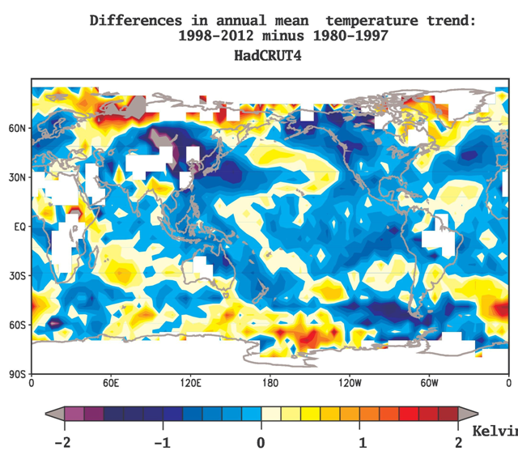
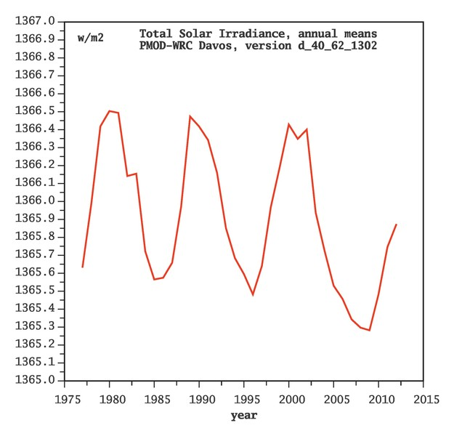
Signal detected …
Possible explanations:
Rare coincidence; if the present trend is maintained, then this cause is getting very improbable
Internal variability underestimated by GHG scenarios
Sensitivity to elevated GHG presence overestimated
Another factor, unaccounted for in the scenarios is active,
Or, in short, models have a problem or prescribed forcing factors are incomplete.

Slide 12
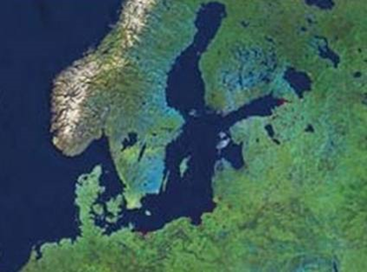
Data
Parameters and observed datasets used:
2m Temperature CRU, EOBS
Precipitation CRU, EOBS
Mean Sea-level pressure HadSLP2
Surface solar radiation MFG Satellites
Models:
10 simulations of RCMs from ENSEMBLES project.
Estimating natural variability:
2,000-year high-resolution regional climate Palaeosimulation (Gómez-Navarro et al, 2013) is used to estimate natural (internal+external) variability.
Forcing
Boundary forcing of RCMs by global scenarios exposed to GS (greenhouse gases and Sulfate aerosols) forcing
RCMs are forced only by elevated GHG levels; the regional response to changing aerosol presence is unaccounted for.
“Signal”
(2071-2100) minus (1961-1990); scaled to change per decade.
Baltic Sea region
12

Slide 13
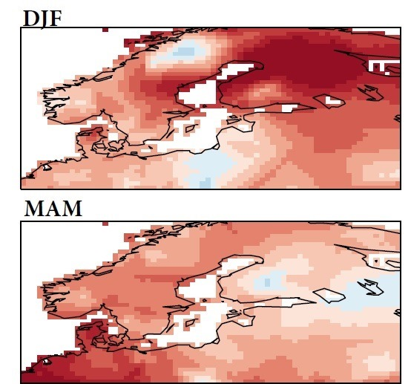
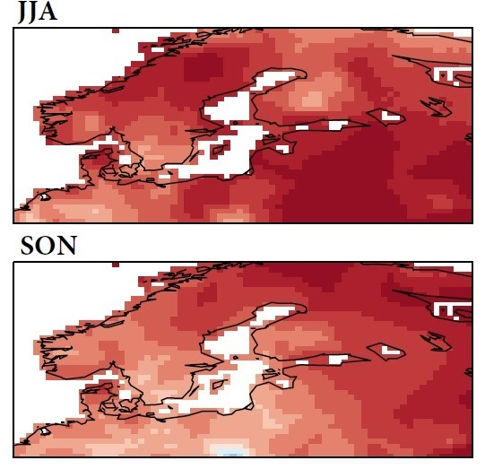
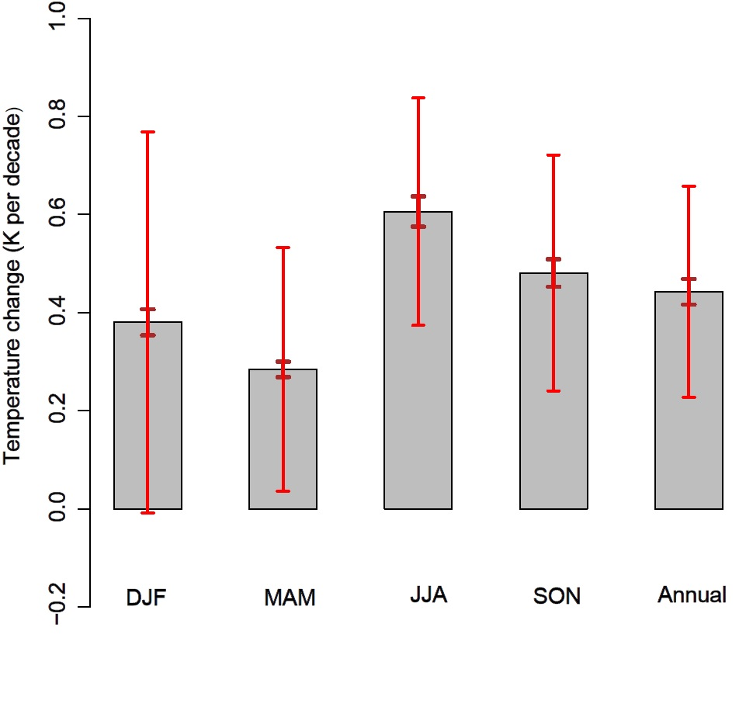
Observed temperature trends (1982-2011)
Observed CRU, EOBS (1982-2011)
95th-%tile of „non-GS“ variability,
derived from 2,000-year palaeo-simulations
An external cause is needed for explaining the recently observed annual and seasonal warming over the Baltic Sea area, except for winter (with < 2.5% risk of error)
13

Slide 14
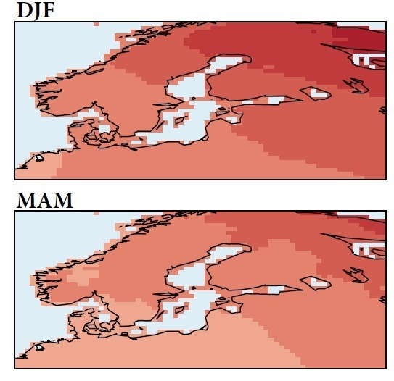
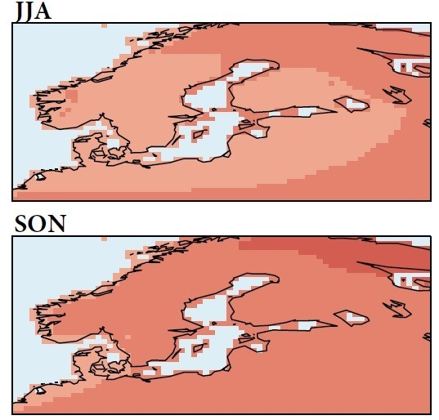
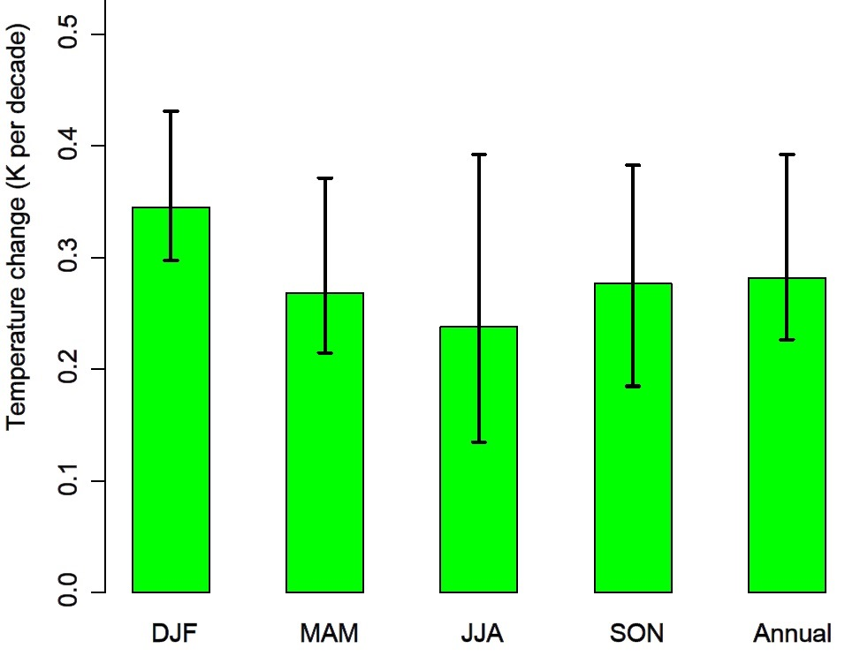
Projected temperature trends
Projected GS signal, A1B scenario
10 simulations (ENSEMBLES)
The spread of trends of 10 RCM projections
All A1B scenarios from the 10 RCM simulations project positive trends of temperature in all seasons.
14

Slide 15
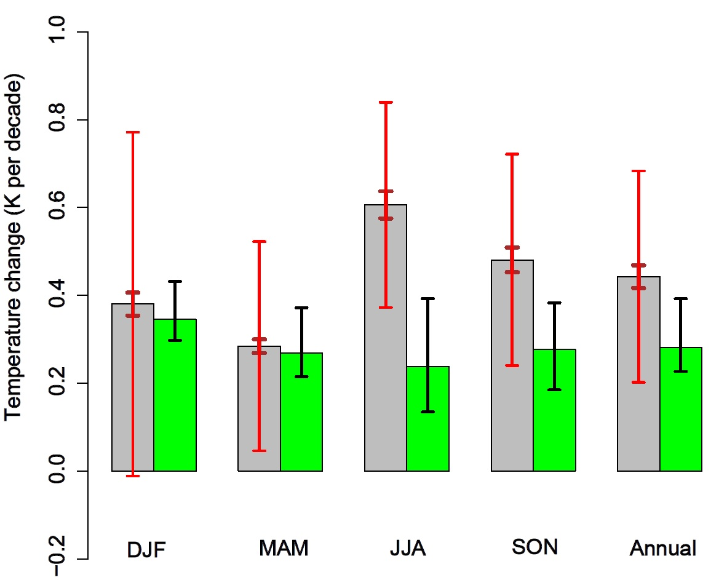
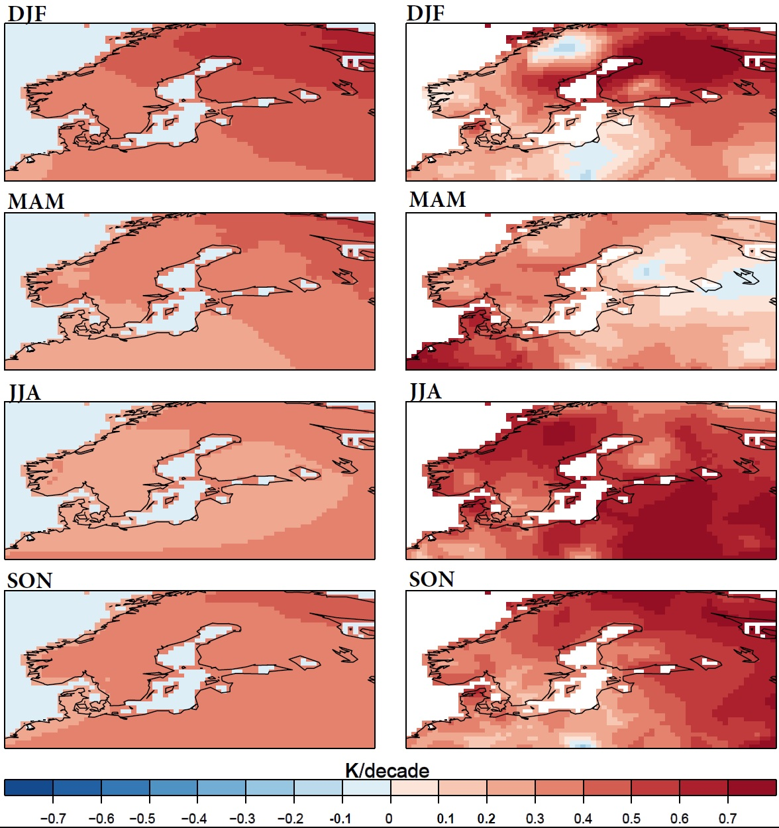
Observed and projected temperature trends (1982-2011)
Observed CRU, EOBS (1982-2011)
Projected GS signal
patterns (RCMs)
Observed trend
patterns (CRU)
Projected GS signal, A1B scenario
10 simulations (ENSEMBLES)
DJF and MAM changes can be explained by dominantly GHG driven scenarios
None of the 10 RCM climate projections capture the observed annual and seasonal warming in summer (JJA) and autumn (SON).
15

Slide 16
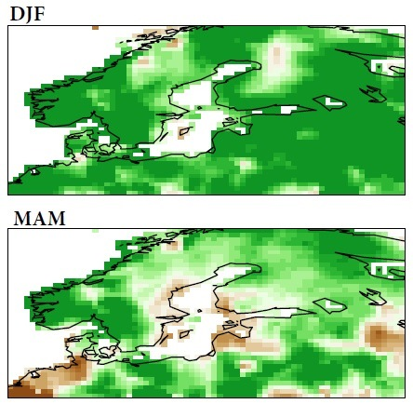
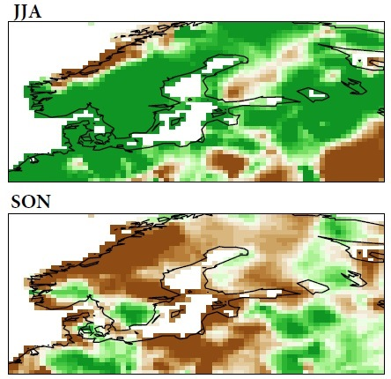
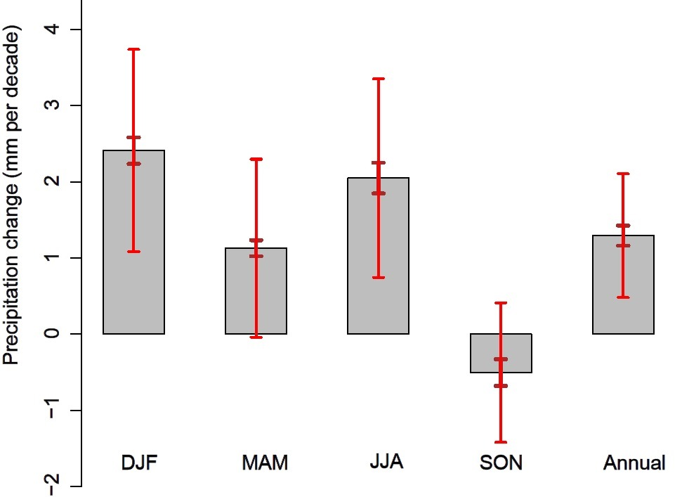
Observed precipitation trends (1972-2011)
Observed CRU, EOBS (1972-2011)
95th-%tile of „non-GHG“ variability,
derived from 2,000-year palaeo-simulations
The annual and seasonal observed trends show more precipitation in the region, except in autumn (SON) when both CRU and EOBS describe drying.
In winter (DJF) and summer (JJA) externally forced changes are detectable.
16

Slide 17
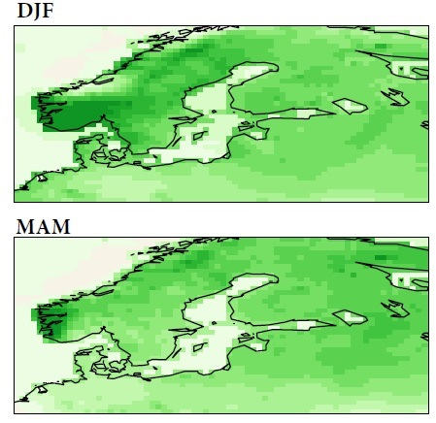
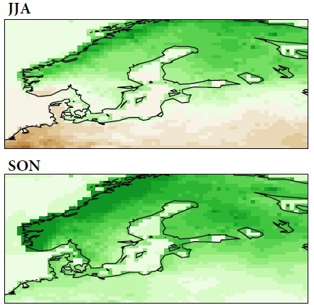
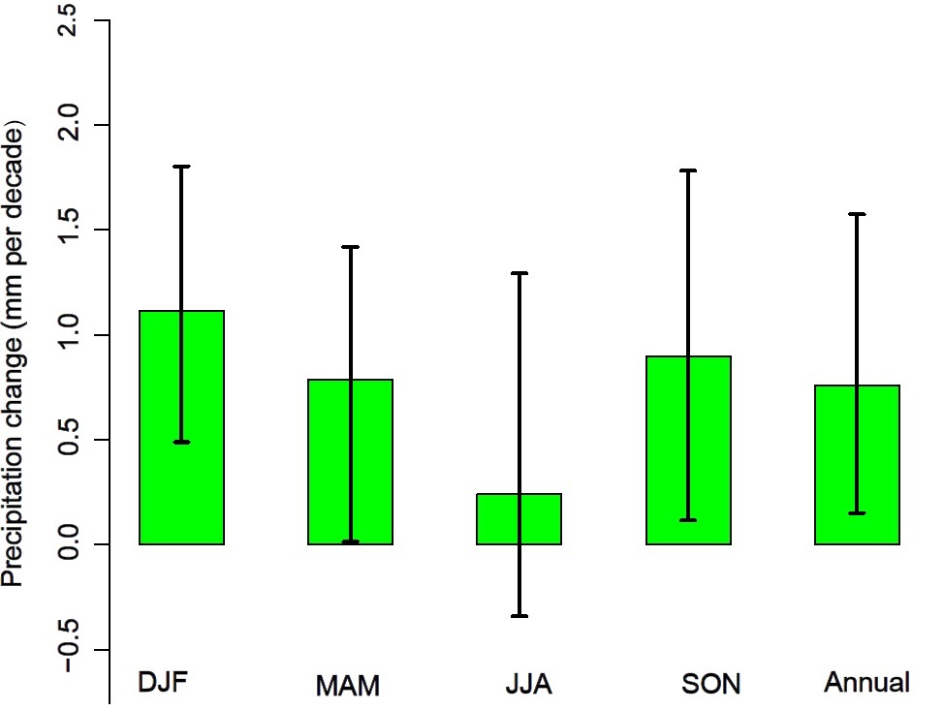
Projected precipitation trends
Projected GS signal, A1B scenario
10 simulations (ENSEMBLES)
The spread of trends of 10 RCM projections
All A1B scenarios from the 10 simulations project positive trends of precipitation in all seasons, except in summer that 3 out of 10 scenarios show drier conditions.
Under increasing GHG concentrations more precipitation is expected.
17

Slide 18
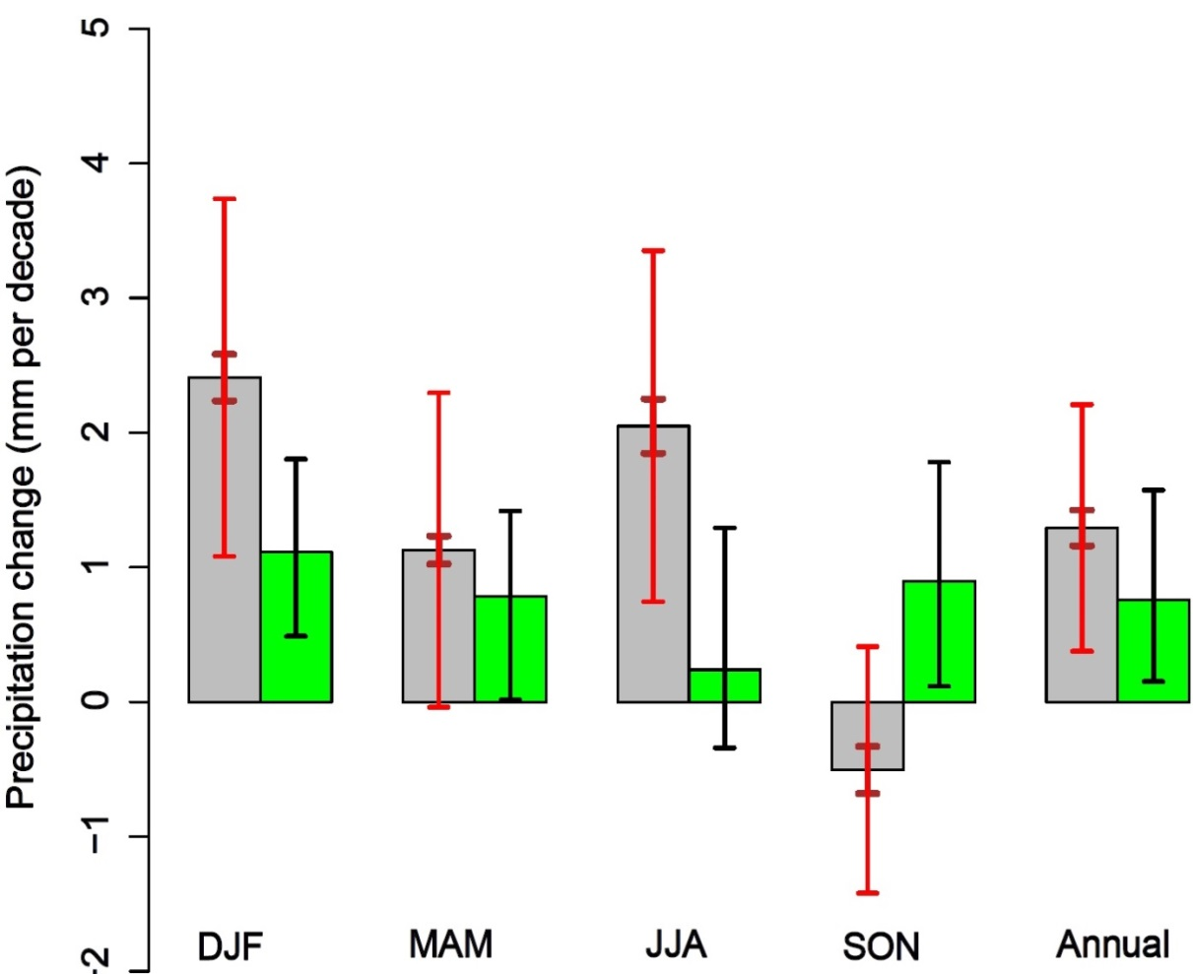
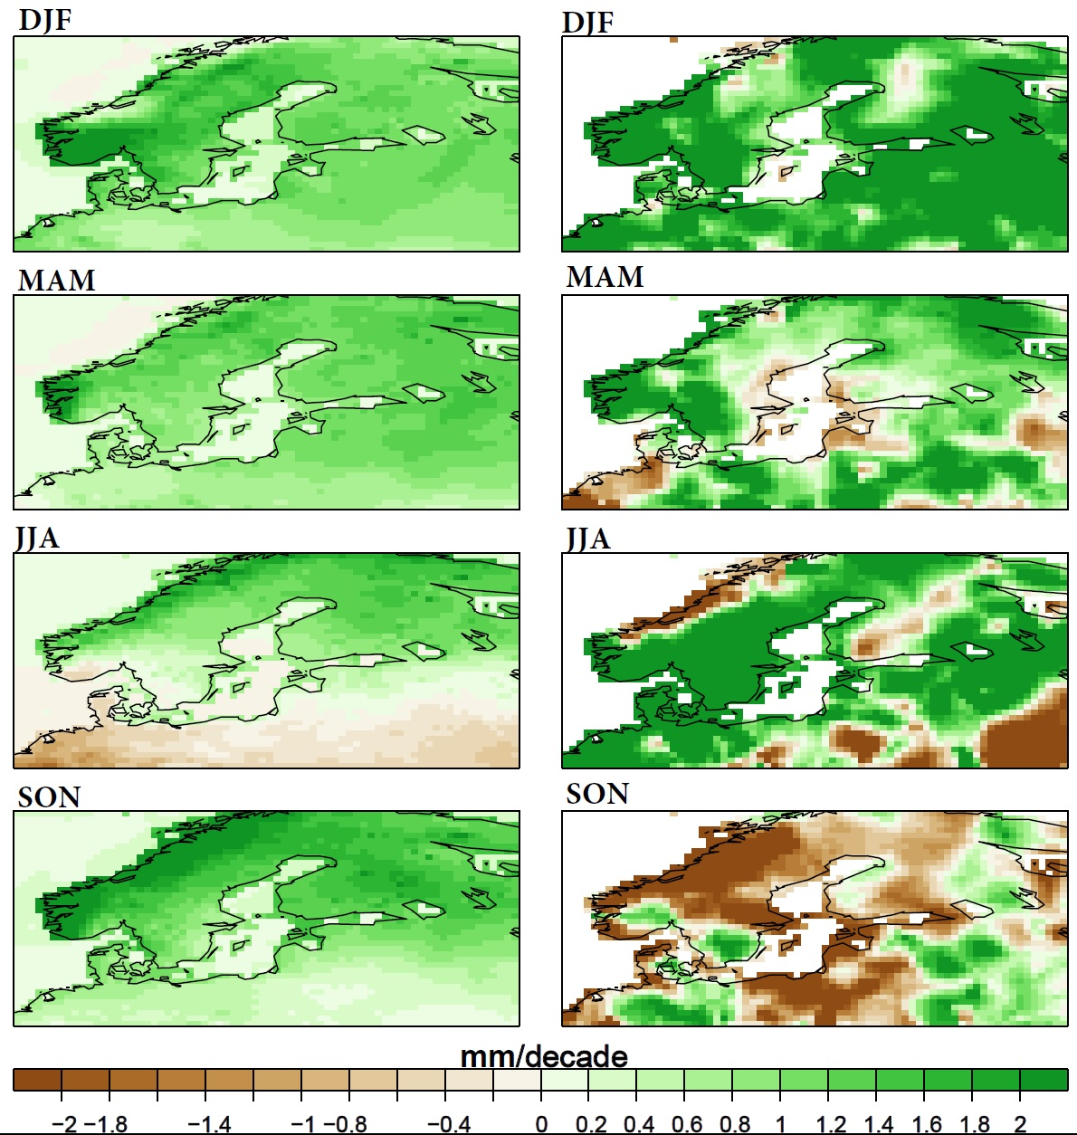
Observed and projected precipitation trends (1972-2011)
Projected GS signal
patterns (RCMs)
Observed trend
patterns
Observed 1972-2011 (CRU, EOBS)
Projected GS signal (ENSEMBLES)
In autumn (SON) the observed negative trends of precipitation contradicts the upward trends suggested by 10 climate change scenarios, irrespective of the observed dataset used.
Also in JJA, the observed trend is NOT within the range of variations of the scenarios.
18

Slide 19
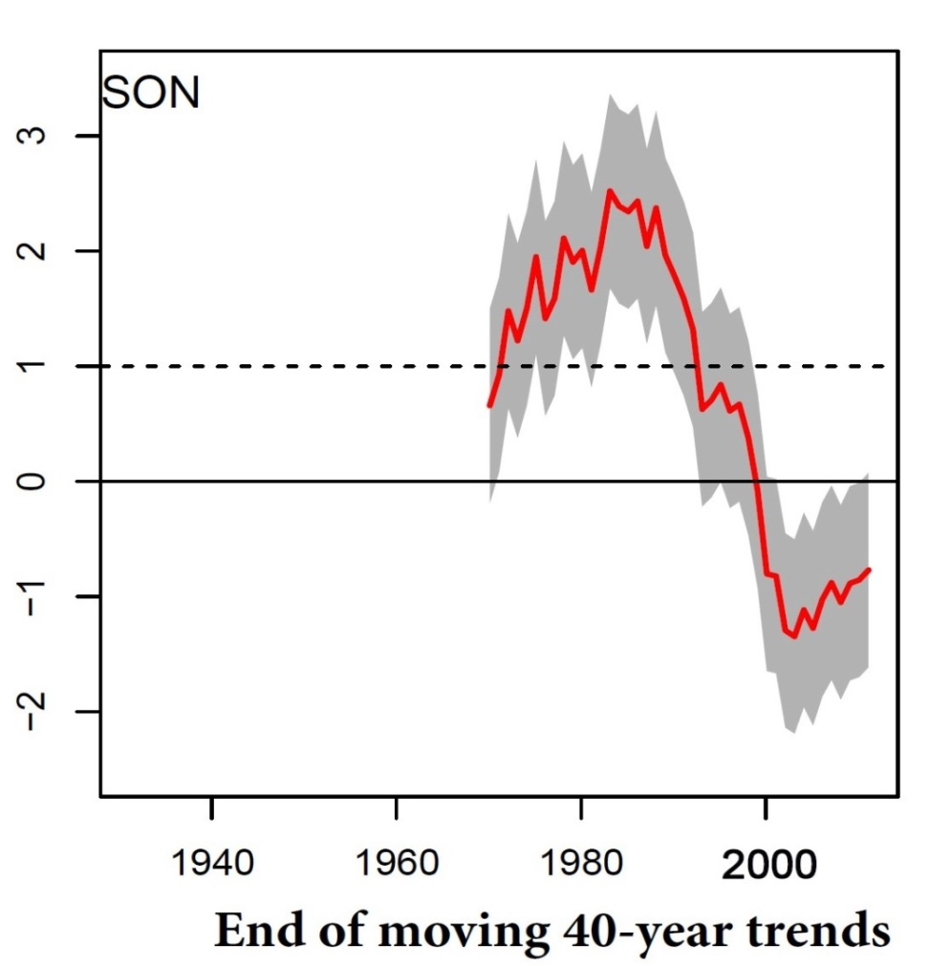
Precipitation 1931-2011 (SON)
Regression indices in SON
The detection of outright sign mismatch of observed and projected trends in autumn (SON) is obvious with negative regression indices of 40-year trends ending in 1999 and later on.
Regression indices of observed moving 40-year trends onto the multi-model mean GS signal. The gray shaded area indicates the 95% uncertainty range of regression indices, derived from fits of the regression model to 2,000-year paleo-simulations.

Slide 20
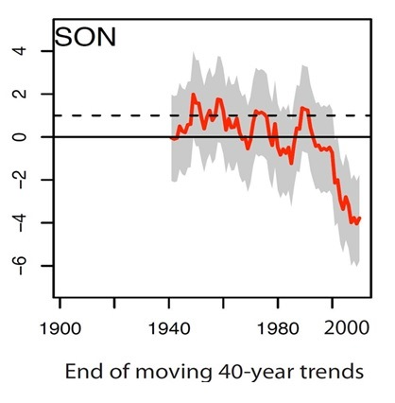

Precipitation 1931-2011 (SON)
For autumn the same contradiction is also observed over the Mediterranean region.
Mediterranean region
Regression indices
The negative regression indices are significantly beyond the range of regression indices of unforced trends with GHG signals pattern in late 20th century. Points to the presence of an external forcing, which is not part of the global scenarios..
Barkhordarian, A., H. von Storch, and J. Bhend, 2013: The expectation of future precipitation change over the Mediterranean region is different from what we observe. Climate Dynamics, 40, 225-244 DOI: 10.1007/s00382-012-1497-7

Slide 21
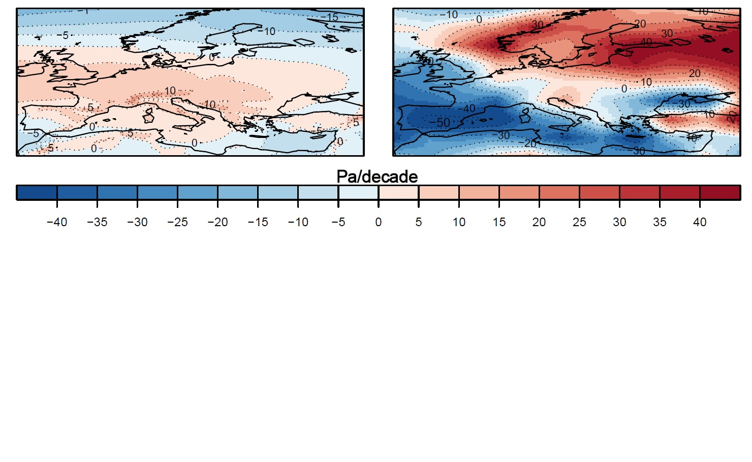
Changes in large-scale circulation (SON)
Mean Sea-level pressure (SON)
Projected GS signal pattern (RCMs)
Observed trend pattern (1972-2011)
Observed trend pattern shows areas of decrease in SLP over the Med. Sea and areas of increase in SLP over the northern Europe. Observed trend pattern of SLP in SON contradicts regional climate projections.
The mismatch between projected and observed precipitation in autumn is already present in the atmospheric circulation.

Slide 22
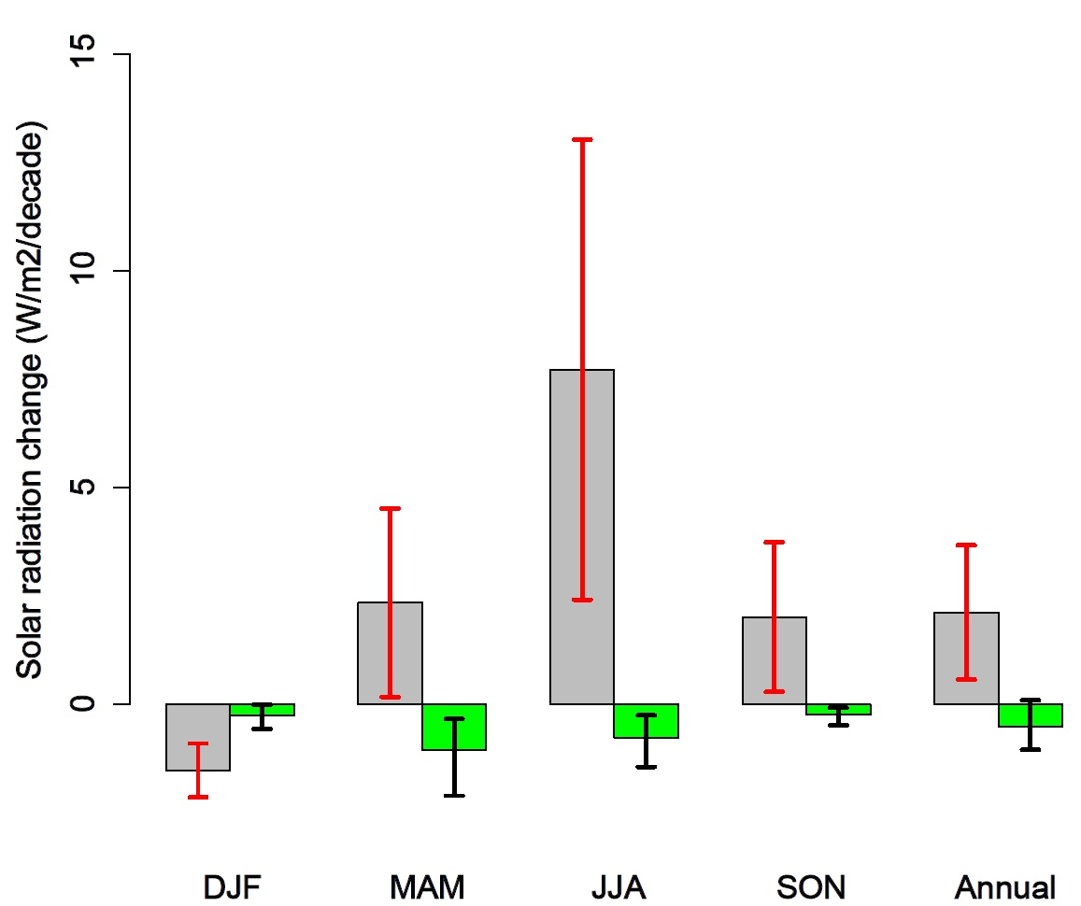

Solar surface irradiance in the Baltic Sea R.
Observed 1984-2005 (MFG Satellites)
Projected GS signal (ENSEMBLES)
1880-2004 development of sulphur dioxide emissions in Europe (Unit: Tg SO2). (after Vestreng et al., 2007 in BACC-2 report, Sec 6.3 by HC Hansson
A possible candidate to explain the observed deviations of the trends in summer and autumn, which are not captured by 10 RCMs, could be the effect of changing regional aerosol emissions

Slide 23
Other cases
Stratosphere cooling
Arctic sea ice
Damages caused by land-falling US Hurricanes
Storm surge heights in Hamburg

Slide 24
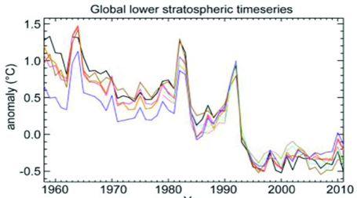
Other cases that need attention
Lack of recent cooling of lower stratosphere

Slide 25
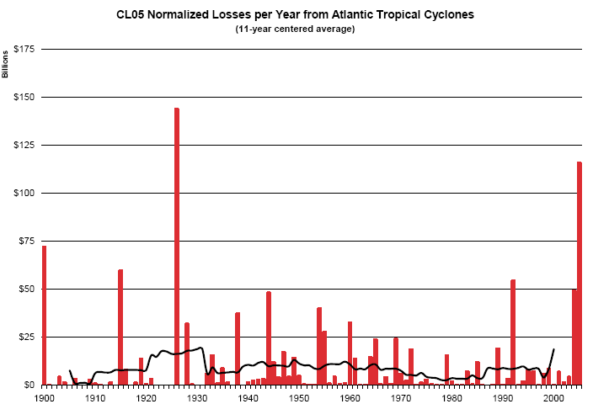
Is the massive increase in damages attributable to extreme weather conditions?
Losses from Atlantic Hurricanes
Estimation of damage if presence of people and values along the coast would have been constant – the change is attributable to socio-economic development
Pielke, Jr., R.A., Gratz, J., Landsea, C.W., Collins, D., Saunders, M., and Musulin, R., 2008. Normalized Hurricane Damages in the United States: 1900-2005. Natural Hazards Review

Slide 26
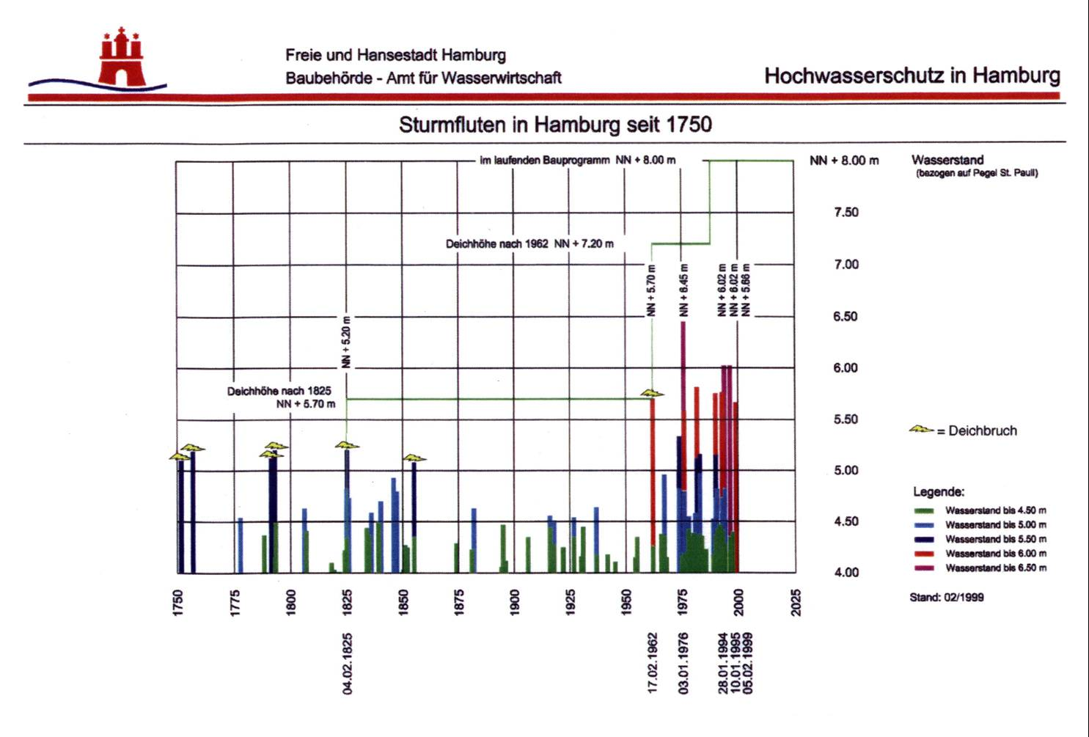
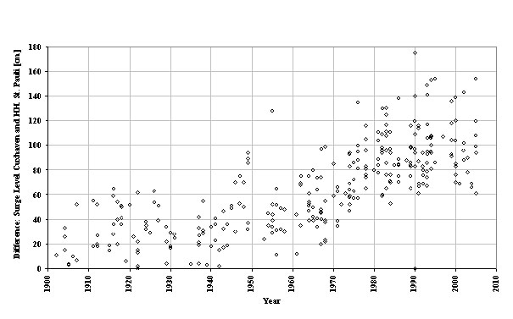
Storm surges in Hamburg
Difference in storm surge height between Cuxhaven and Hamburg
Local surge height massively increased since 1962 – attributable to the deepening of the shipping channel and the reducing of retention areas since 1962.

Slide 27
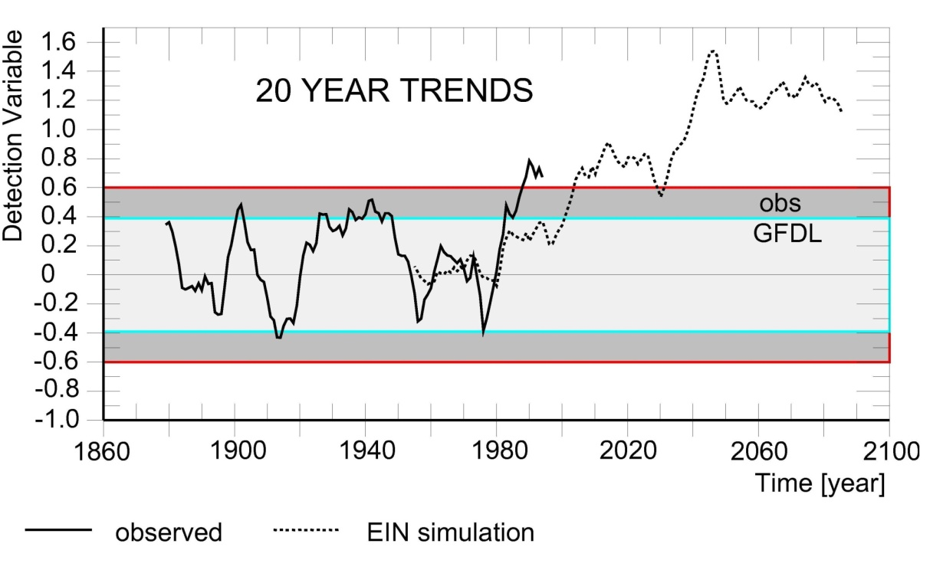
A synthetic case … from 1995
Discussion: Detection
Statistics of weather (climate) and impacts are changing beyond the range of internal dynamics.
Detection succeeds nowadays also without reference to specific guess patterns, but as a mere proof of instationarity.
We may apply the detection concept also for determining if a change differs from any given climate regime
(such as scenarios A1B).
Question – what happens, when
detection is successful at some time,
but not so at a later time?

Slide 28
Discussion: Attribution
Attribution needs guess patterns describing the expected effect of different drivers.
Non-attribution may be attained by detecting deviation from a given climate regime (the case of the stagnation)
“Non-attribution” means only: considered factor is not sufficient to explain change exclusively.
Regional and local climate studies need guess patterns (in space and time) of more drivers, such as regional aerosol loads, land-use change including urban effects (the case of the Baltic Sea Region)
Impact studies need guess patterns of other drivers, mostly socio-economic drivers (the case of Hamburg storm surges and hurricane damages)
General: Consistency of change with GHG expectations is a demonstration of possibility and plausibility; but insufficient to claim exclusiveness. Different sets of hypotheses need to be discussed before arriving at an attribution.

